Slide 1

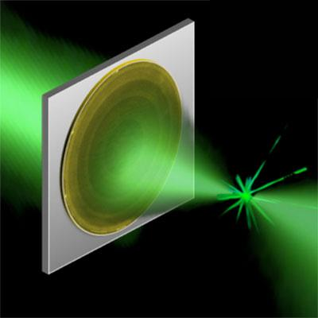
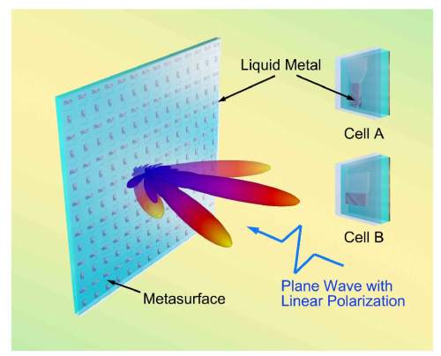
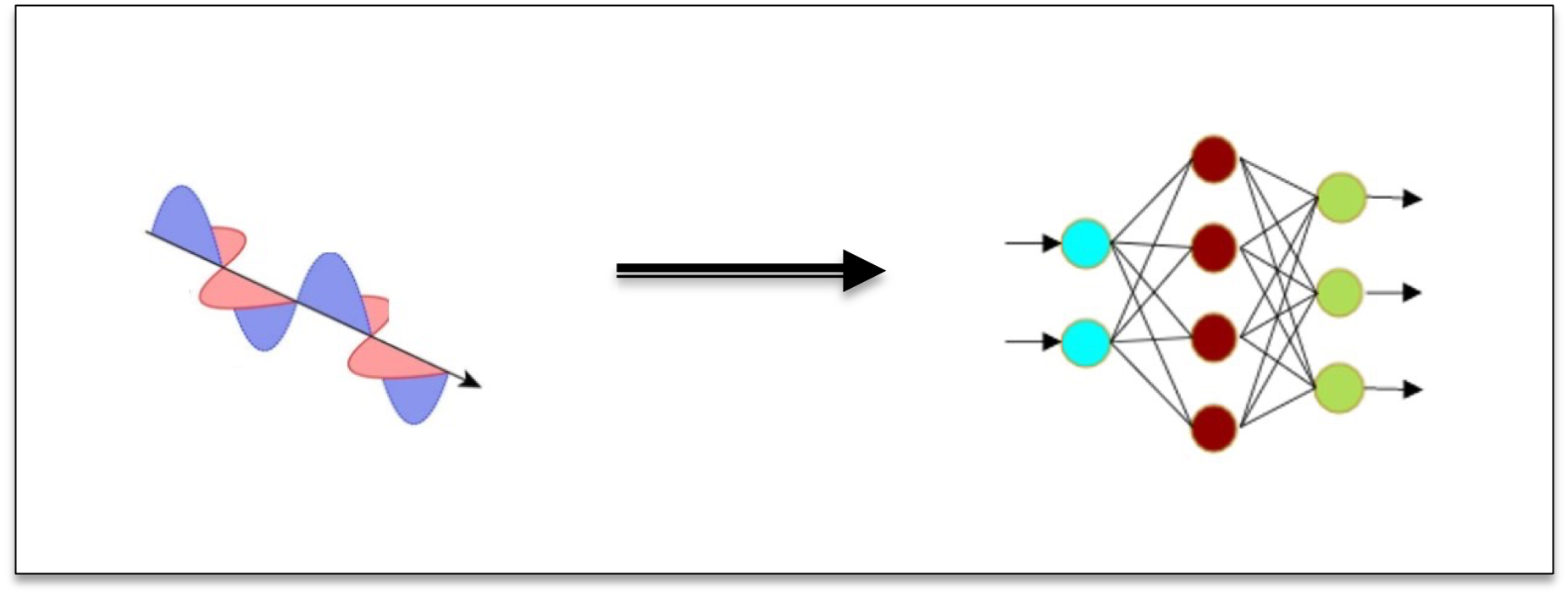
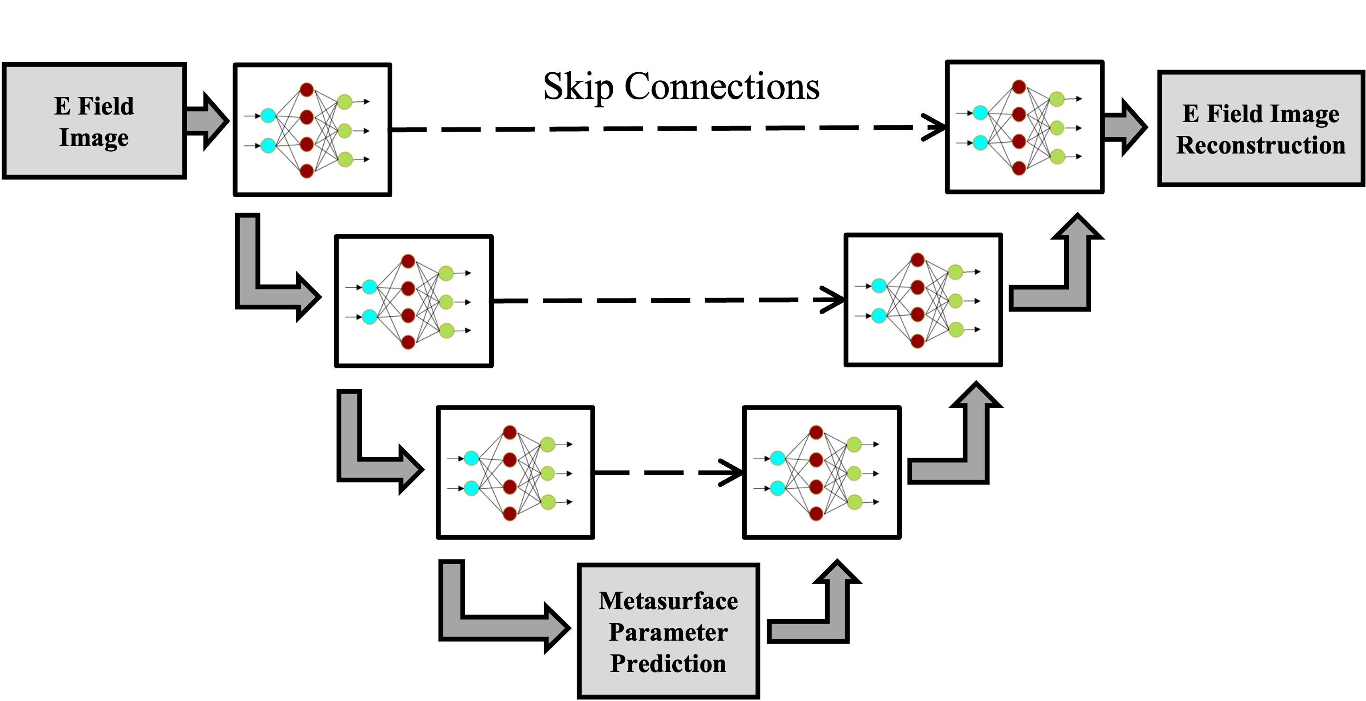


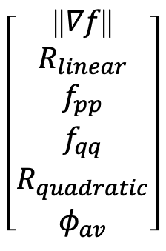
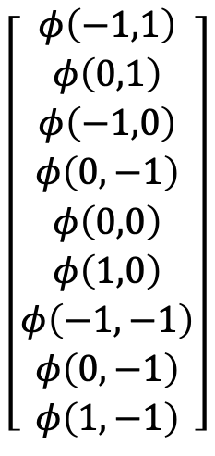
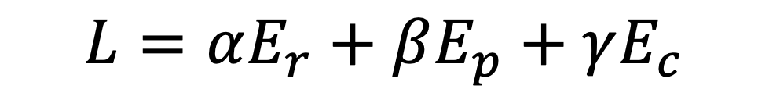
Mapping Meta-atoms to Near Field Response for Inverse Design of Optical Metasurfaces
Andy G Varnerª
Marshall B. Lindsay, Charlie T. Veal, Scott D. Kovaleski, Derek T. Andersonª
Electrical Engineering and Computer Science Department, University of Missouri, Columbia, MO
Motivation – Optical Metasurface Design
Process Overview – Prior Work
Optical metasurfaces are awesome! But they are very difficult to design. They are:
Computationally expensive
Not general
Unintuitive
The u-net is trained with a multi-criteria loss function,
$$L=αE_{r}+βE_{p}+γE_{c}$$
$$\left[\begin{aligned}φ\left(−1,1\right) \\ φ\left(0,1\right) \\ φ\left(−1,0\right) \\ φ\left(0,−1\right) \\ φ\left(0,0\right) \\ φ\left(1,0\right) \\ φ\left(−1,−1\right) \\ φ\left(0,−1\right) \\ φ\left(1,−1\right)\end{aligned}\right]$$
$$\left[\begin{aligned}\text{||}∇f\text{||} \\ R_{linear} \\ f_{pp} \\ f_{qq} \\ R_{quadratic} \\ φ_{av}\end{aligned}\right]$$
We want to translate an electromagnetics/physics design problem for a machine learning model.
Reconstruction
Phase
Curvature
Experiments
Models/Experiments based on tuning of loss function
1. U-net with skip connections
2. Break skip connections
Predicted Phase Delays
Predicted Phase Delays
1. Results with Skip Connections
Training and Validation Loss
Quantitative
Qualitative
|Difference| Reconstruction Truth
|Difference| Resim Truth
Model Reconstruction
Resimulation
2. Results with Broken Skip Connections
Training and Validation Loss
Quantitative
Qualitative
RPC
RPC
|Difference| Reconstruction Truth
Conclusion
Model Reconstruction
Resimulation
More Future Work
Without the skip connections, learning is a little worse, especially in terms of overall loss.
As expected, reconstruction loss still dominates, but the near-zero curve is a little less zero than with skip connections intact.
We actually have lower error in terms of phase and curvature predictions across all models! Does this mean reconstruction loss hampers the ability to learn in the latent space?
There’s a lot in every area of the process!!
We should work on changing alpha, beta, and gamma parameters of the loss function
Simplify the curvature term of the loss function

